Slide 1
Image Restoration and Compression

Slide 2
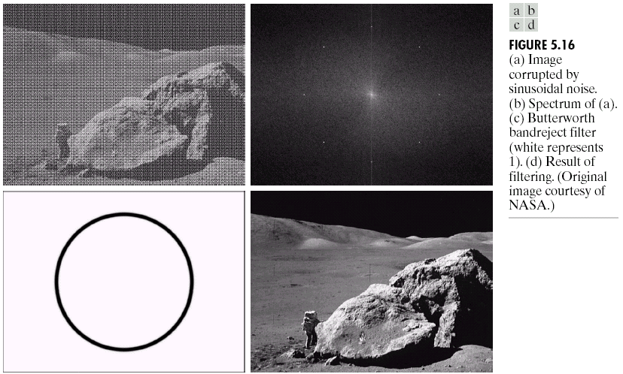
What is Image Restoration?
Image restoration attempts to restore images that have been degraded
Identify the degradation process and attempt to reverse it
Similar to image enhancement, but more objective

Slide 3
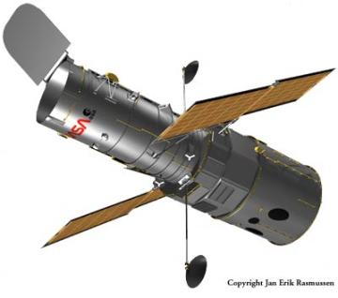
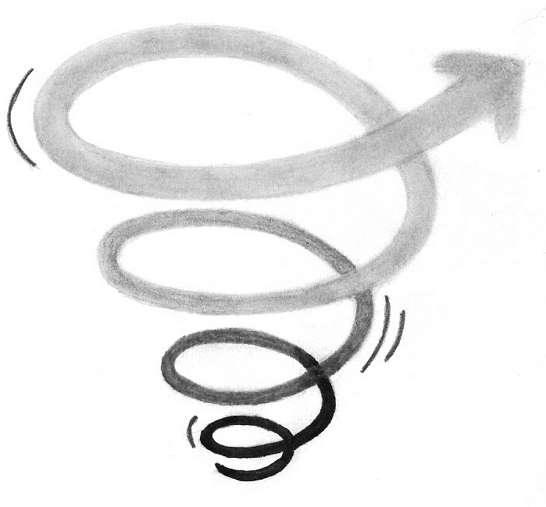
Noise and Images
The sources of noise in digital images arise during image acquisition (digitization) and transmission
Imaging sensors can be affected by ambient conditions
Interference can be added to an image during transmission

Slide 4
Noise and Images

Slide 5
Noise and Images

Slide 6
Noise and Images

Slide 7
Noise and Images

Slide 8
Noise Model
We can consider a noisy image to be modelled as follows:
where f(x, y) is the original image pixel, η(x, y) is the noise term and g(x, y) is the resulting noisy pixel
If we can estimate the model the noise in an image is based on this will help us to figure out how to restore the image

Slide 9
Noise Corruption Example
Original Image
x
Noisy Image
x
54
52
57
55
56
52
51
50
49
51
50
52
53
58
51
51
52
52
56
57
60
48
50
51
49
53
59
63
49
51
52
55
58
64
67
148
154
157
160
163
167
170
151
155
159
162
165
169
172
Image f (x, y)
Image f (x, y)
y
y

Slide 10
Noise Models

Slide 11
Noise Models

Slide 12
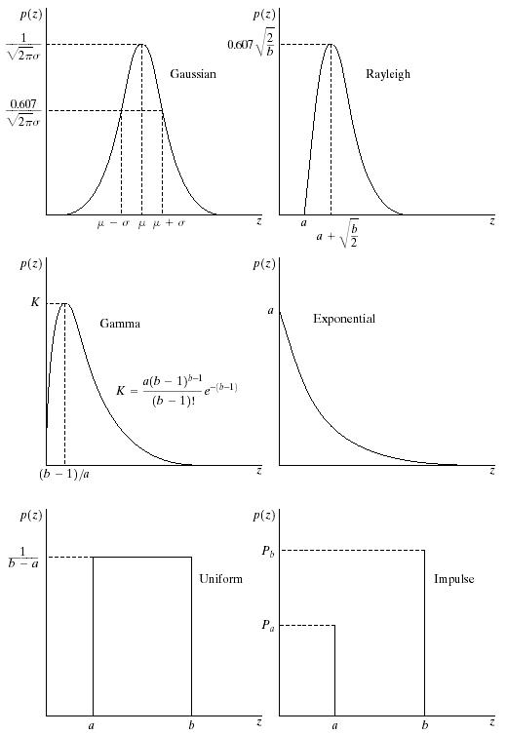

Noise Models
There are many different models for the image noise term η(x, y):
Gaussian
Most common model
Rayleigh
Erlang
Exponential
Uniform
Impulse
Salt and pepper noise
Gaussian
Rayleigh
Erlang
Exponential
Images taken from Gonzalez & Woods, Digital Image Processing (2002)
Uniform
Impulse

Slide 13
Noise Models

Slide 14
Noise Models

Slide 15
Noise Models

Slide 16
Noise Models

Slide 17
Noise Models

Slide 18
Noise Models

Slide 19
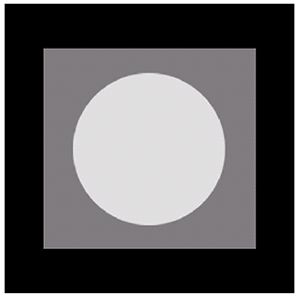
Noise Example
The test pattern to the right is ideal for demonstrating the addition of noise
The following slides will show the result of adding noise based on various models to this image
Image
Images taken from Gonzalez & Woods, Digital Image Processing (2002)
Histogram to go here
Histogram

Slide 20
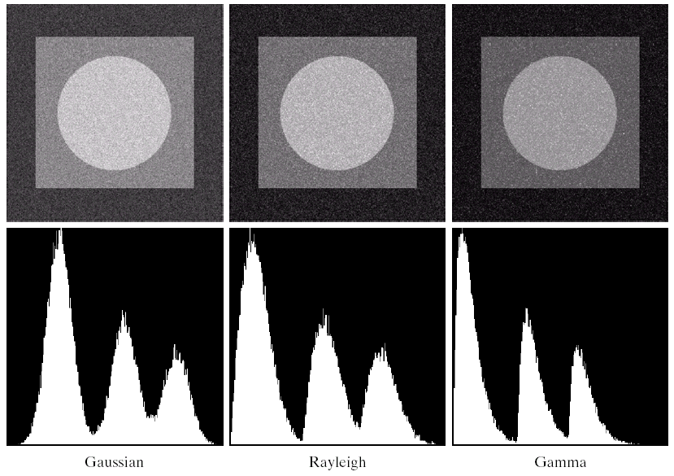
Noise Example (cont…)
Images taken from Gonzalez & Woods, Digital Image Processing (2002)
Gaussian
Rayleigh
Erlang

Slide 21
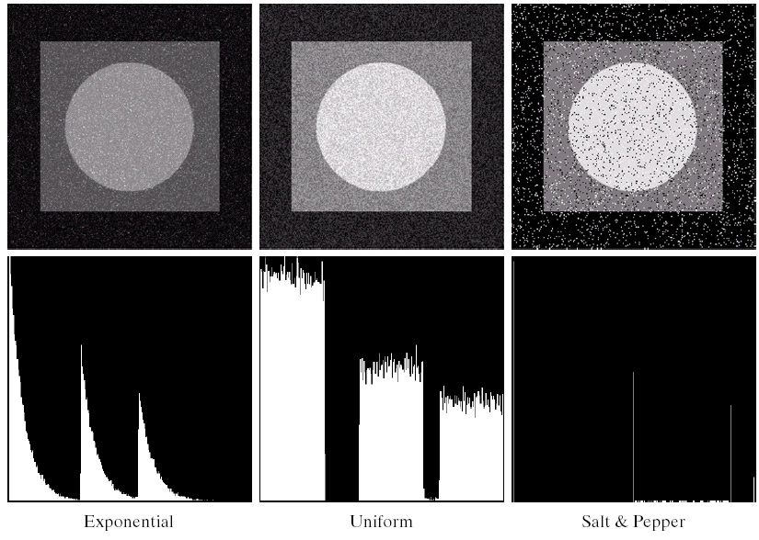
Noise Example (cont…)
Images taken from Gonzalez & Woods, Digital Image Processing (2002)
Histogram to go here
Exponential
Uniform
Impulse

Slide 22
Noise Models

Slide 23
Noise Models

Slide 24
Noise Models

Slide 25
Filtering to Remove Noise
We can use spatial filters of different kinds to remove different kinds of noise
The arithmetic mean filter is a very simple one and is calculated as follows:
This is implemented as the simple smoothing filter
Blurs the image to remove noise
¹/₉ | ¹/₉ | ¹/₉
¹/₉ | ¹/₉ | ¹/₉
¹/₉ | ¹/₉ | ¹/₉

Slide 26
Noise Removal Example
Original Image
x
Filtered Image
x
54
52
57
55
56
52
51
50
49
51
50
52
53
58
51
204
52
52
0
57
60
48
50
51
49
53
59
63
49
51
52
55
58
64
67
148
154
157
160
163
167
170
151
155
159
162
165
169
172
Image f (x, y)
Image f (x, y)
y
y

Slide 27
Other Means
There are different kinds of mean filters all of which exhibit slightly different behaviour:
Geometric Mean
Harmonic Mean
Contraharmonic Mean

Slide 28
Other Means (cont…)
There are other variants on the mean which can give different performance
Geometric Mean:
Achieves similar smoothing to the arithmetic mean, but tends to lose less image detail

Slide 29
Noise Removal Example
Original Image
x
Filtered Image
x
54
52
57
55
56
52
51
50
49
51
50
52
53
58
51
204
52
52
0
57
60
48
50
51
49
53
59
63
49
51
52
55
58
64
67
148
154
157
160
163
167
170
151
155
159
162
165
169
172
Image f (x, y)
Image f (x, y)
y
y

Slide 30
Other Means (cont…)
Harmonic Mean:
Works well for salt noise, but fails for pepper noise
Also does well for other kinds of noise such as Gaussian noise

Slide 31
Noise Corruption Example
Original Image
x
Filtered Image
x
54
52
57
55
56
52
51
50
49
51
50
52
53
58
51
204
52
52
0
57
60
48
50
51
49
53
59
63
49
51
52
55
58
64
67
50
54
57
60
63
67
70
51
55
59
62
65
69
72
Image f (x, y)
Image f (x, y)
y
y

Slide 32
Other Means (cont…)
Contraharmonic Mean:
Q is the order of the filter and adjusting its value changes the filter’s behaviour
Positive values of Q eliminate pepper noise
Negative values of Q eliminate salt noise

Slide 33
Noise Corruption Example
Original Image
x
Filtered Image
x
54
52
57
55
56
52
51
50
49
51
50
52
53
58
51
204
52
52
0
57
60
48
50
51
49
53
59
63
49
51
52
55
58
64
67
50
54
57
60
63
67
70
51
55
59
62
65
69
72
Image f (x, y)
Image f (x, y)
y
y

Slide 34
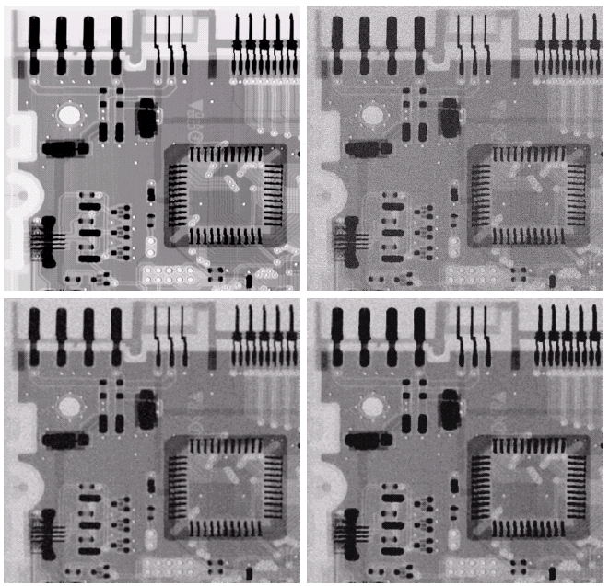
Noise Removal Examples
Image Corrupted By Gaussian Noise
Original Image
Images taken from Gonzalez & Woods, Digital Image Processing (2002)
After A 3*3 Arithmetic Mean Filter
After A 3*3 Geometric Mean Filter

Slide 35
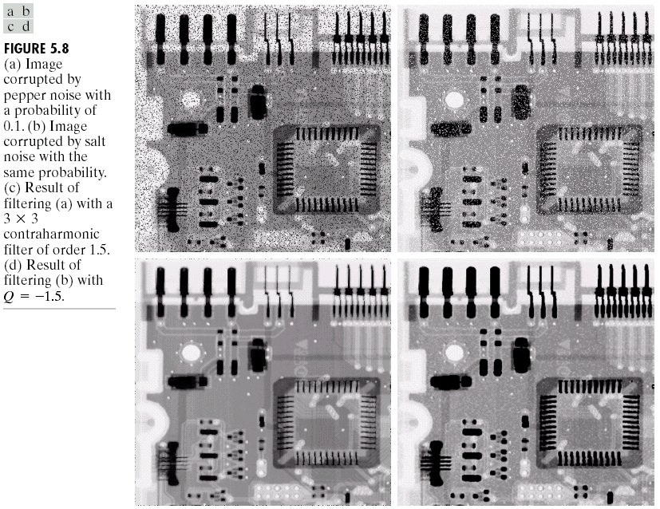
Noise Removal Examples (cont…)
Image Corrupted
By Pepper Noise
Images taken from Gonzalez & Woods, Digital Image Processing (2002)
Result of Filtering Above With 3*3 Contraharmonic Q=1.5

Slide 36
Noise Removal Examples (cont…)
Image Corrupted
By Salt Noise
Images taken from Gonzalez & Woods, Digital Image Processing (2002)
Result of Filtering Above With 3*3 Contraharmonic Q=-1.5

Slide 37
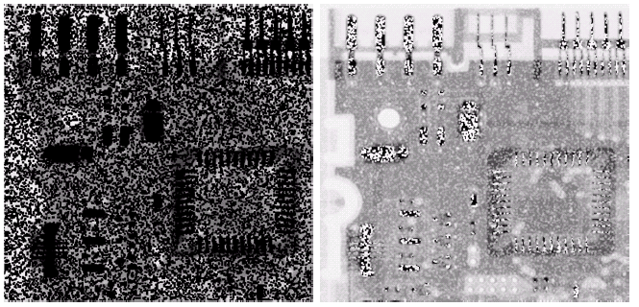
Contraharmonic Filter: Here Be Dragons
Choosing the wrong value for Q when using the contraharmonic filter can have drastic results
Images taken from Gonzalez & Woods, Digital Image Processing (2002)

Slide 38
Order Statistics Filters
Spatial filters that are based on ordering the pixel values that make up the neighbourhood operated on by the filter
Useful spatial filters include
Median filter
Max and min filter
Midpoint filter
Alpha trimmed mean filter
Images taken from Gonzalez & Woods, Digital Image Processing (2002)

Slide 39
Median Filter
Median Filter:
Excellent at noise removal, without the smoothing effects that can occur with other smoothing filters
Particularly good when salt and pepper noise is present

Slide 40
Noise Corruption Example
Original Image
x
Filtered Image
x
54
52
57
55
56
52
51
50
49
51
50
52
53
58
51
204
52
52
0
57
60
48
50
51
49
53
59
63
49
51
52
55
58
64
67
50
54
57
60
63
67
70
51
55
59
62
65
69
72
Image f (x, y)
Image f (x, y)
y
y

Slide 41
Max and Min Filter
Max Filter:
Min Filter:
Max filter is good for pepper noise and min is good for salt noise

Slide 42
Noise Corruption Example
Original Image
x
Filtered Image
x
54
52
57
55
56
52
51
50
49
51
50
52
53
58
51
204
52
52
0
57
60
48
50
51
49
53
59
63
49
51
52
55
58
64
67
50
54
57
60
63
67
70
51
55
59
62
65
69
72
Image f (x, y)
Image f (x, y)
y
y

Slide 43
Midpoint Filter
Midpoint Filter:
Good for random Gaussian and uniform noise

Slide 44
Noise Corruption Example
Original Image
x
Filtered Image
x
54
52
57
55
56
52
51
50
49
51
50
52
53
58
51
204
52
52
0
57
60
48
50
51
49
53
59
63
49
51
52
55
58
64
67
50
54
57
60
63
67
70
51
55
59
62
65
69
72
Image f (x, y)
Image f (x, y)
y
y

Slide 45
Alpha-Trimmed Mean Filter
Alpha-Trimmed Mean Filter:
We can delete the d/2 lowest and d/2 highest grey levels
So g_{r}(s, t) represents the remaining mn – d pixels

Slide 46
Alpha-Trimmed Mean Filter

Slide 47
Alpha-Trimmed Mean Filter

Slide 48
Noise Corruption Example
Original Image
x
Filtered Image
x
54
52
57
55
56
52
51
50
49
51
50
52
53
58
51
204
52
52
0
57
60
48
50
51
49
53
59
63
49
51
52
55
58
64
67
50
54
57
60
63
67
70
51
55
59
62
65
69
72
Image f (x, y)
Image f (x, y)
y
y

Slide 49
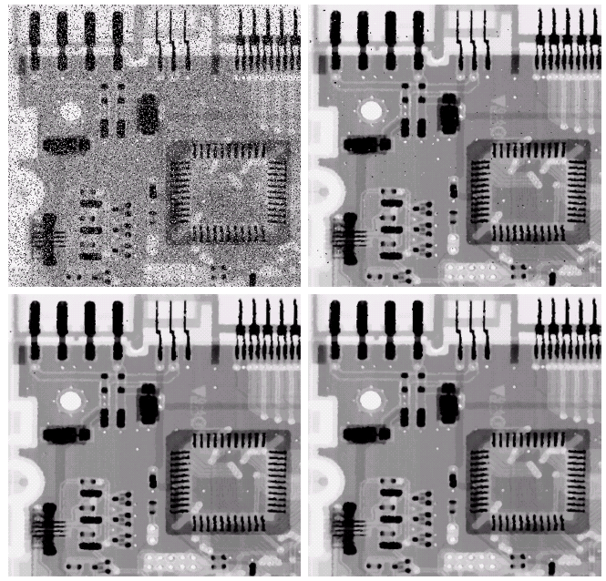
Noise Removal Examples
Image Corrupted By Salt And Pepper Noise
Result of 1 Pass With A 3*3 Median Filter
Images taken from Gonzalez & Woods, Digital Image Processing (2002)
Result of 2 Passes With A 3*3 Median Filter
Result of 3 Passes With A 3*3 Median Filter

Slide 50
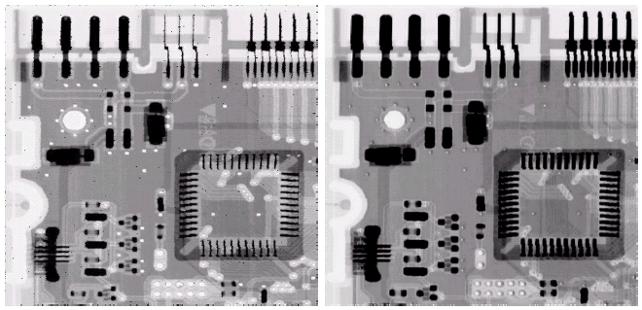
Noise Removal Examples (cont…)
Image Corrupted
By Pepper Noise
Image Corrupted
By Salt Noise
Images taken from Gonzalez & Woods, Digital Image Processing (2002)
Result Of Filtering Above With A 3*3 Max Filter
Result Of Filtering Above With A 3*3 Min Filter

Slide 51
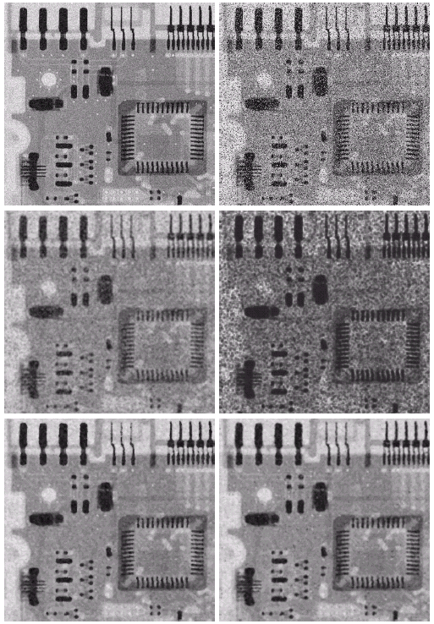
Noise Removal Examples (cont…)
Image Corrupted
By Uniform Noise
Image Further Corrupted
By Salt and Pepper Noise
Filtered By 5*5 Arithmetic Mean Filter
Filtered By 5*5 Geometric Mean Filter
Images taken from Gonzalez & Woods, Digital Image Processing (2002)
Filtered By 5*5 Median Filter
Filtered By 5*5 Alpha-Trimmed Mean Filter

Slide 52
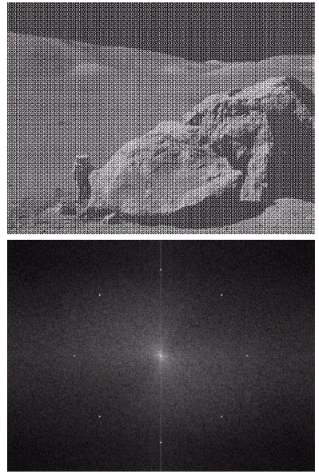
Periodic Noise
Typically arises due to electrical or electromagnetic interference
Gives rise to regular noise patterns in an image
Frequency domain techniques in the Fourier domain are most effective at removing periodic noise
Images taken from Gonzalez & Woods, Digital Image Processing (2002)

Slide 53
Band Reject Filters
Removing periodic noise form an image involves removing a particular range of frequencies from that image
Band reject filters can be used for this purpose
An ideal band reject filter is given as follows:

Slide 54
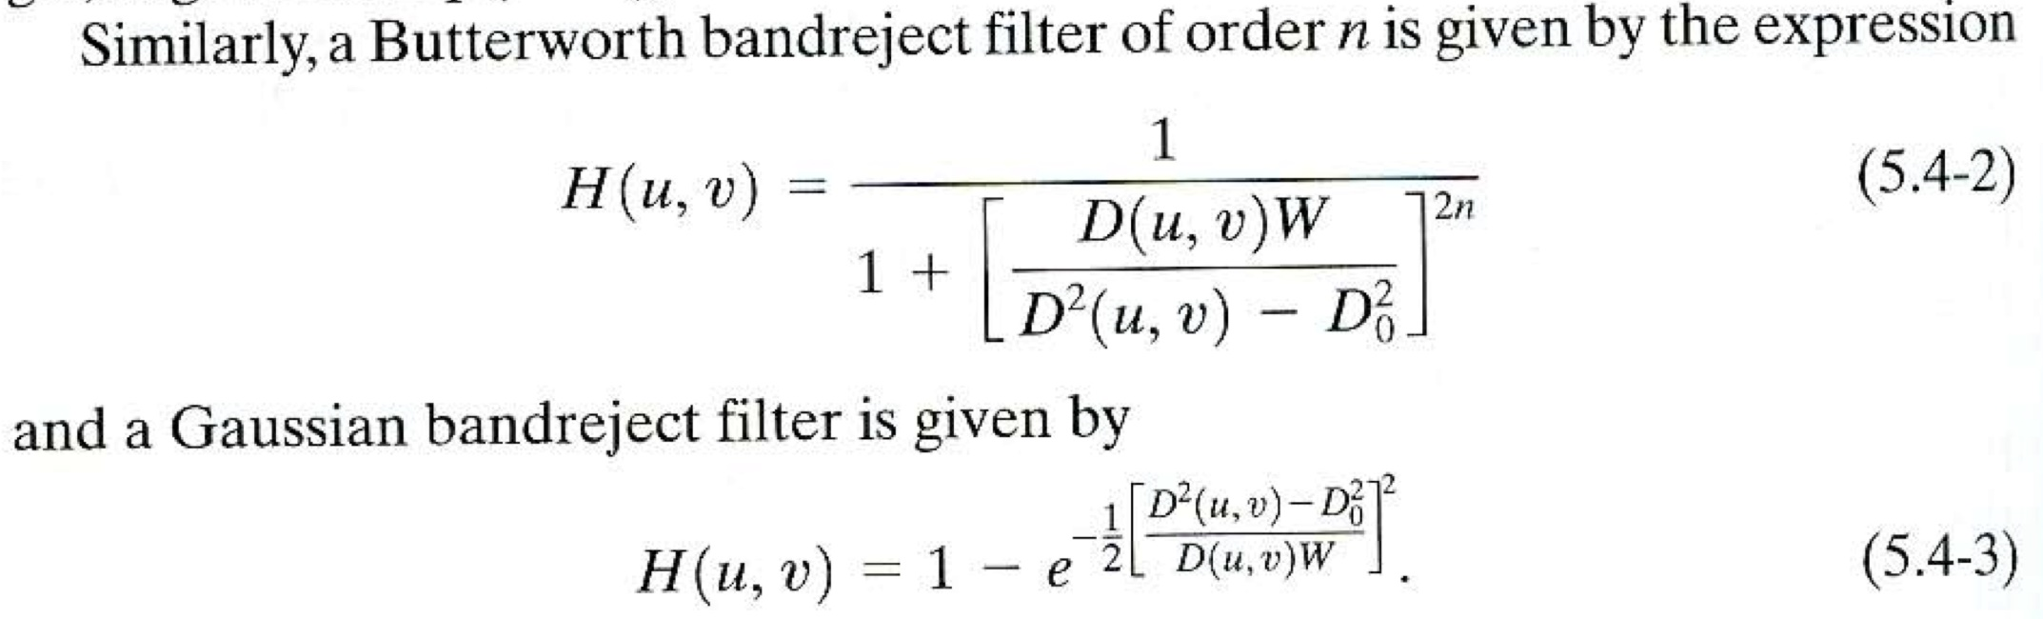
Band Reject Filters

Slide 55
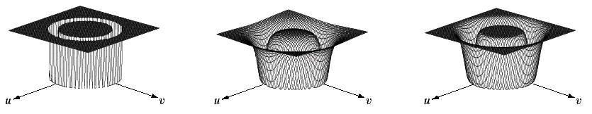
Band Reject Filters (cont…)
The ideal band reject filter is shown below, along with Butterworth and Gaussian versions of the filter
Images taken from Gonzalez & Woods, Digital Image Processing (2002)
Ideal Band Reject Filter
Butterworth Band Reject Filter (of order 1)
Gaussian Band Reject Filter

Slide 56

Band Reject Filter Example
Image corrupted by sinusoidal noise
Fourier spectrum of corrupted image
Images taken from Gonzalez & Woods, Digital Image Processing (2002)
Butterworth band reject filter
Filtered image

Slide 57
Summary
In this lecture we will look at image restoration for noise removal
Restoration is slightly more objective than enhancement
Spatial domain techniques are particularly useful for removing random noise
Frequency domain techniques are particularly useful for removing periodic noise

Slide 58
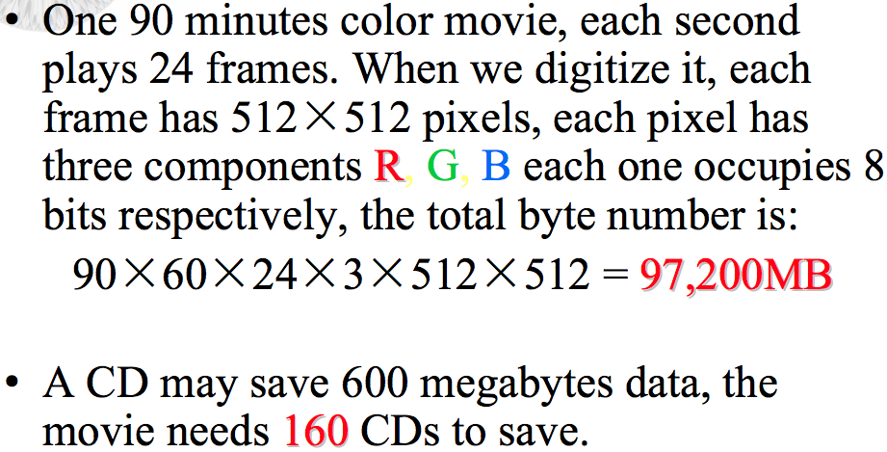
Why we need image compression?
Notes:
58

Slide 59
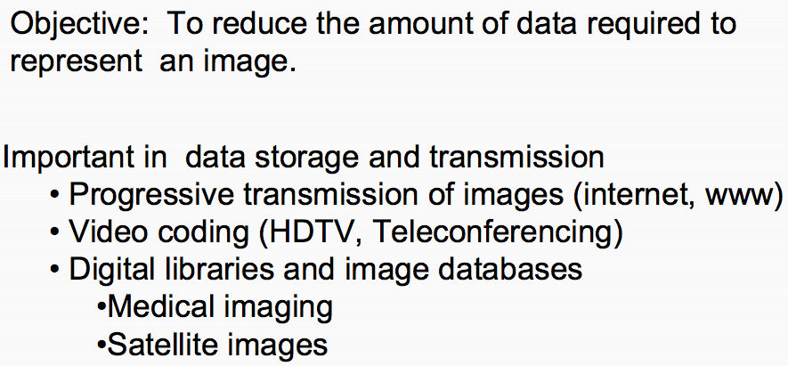
Image Compression
Notes:
59

Slide 60
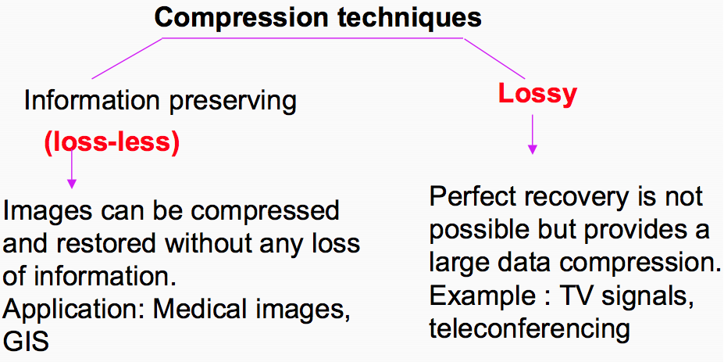
Lossy Vs. Lossless Compression
Notes:
60

Slide 61
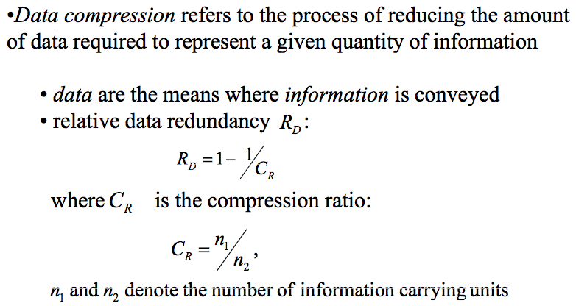
Image Compression
Notes:
61

Slide 62
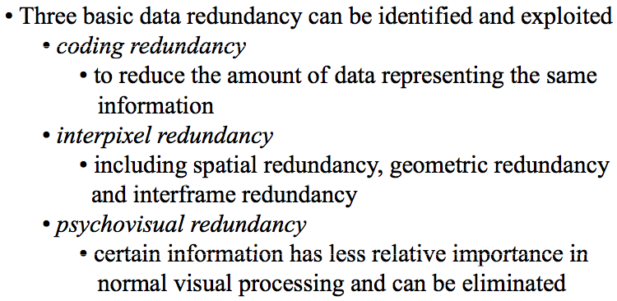
Image Compression
Notes:
62

Slide 63
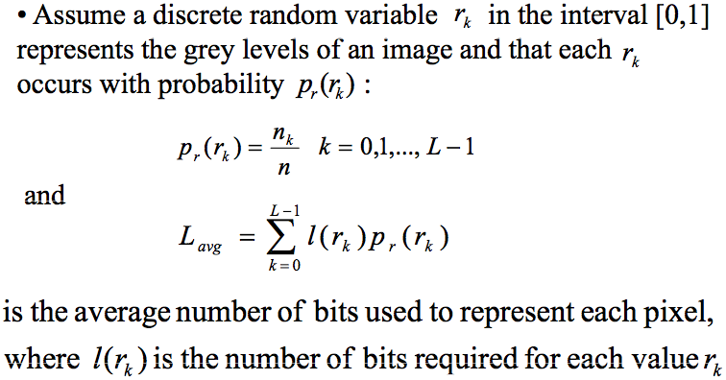
Coding Redundancy
Notes:
63

Slide 64
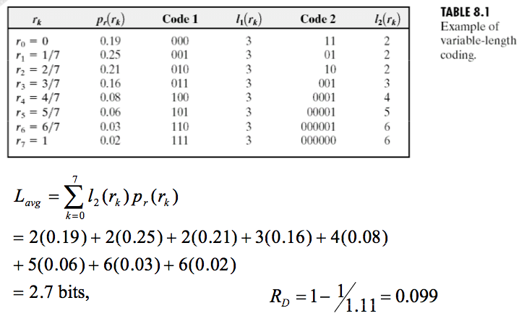
Coding Redundancy
Notes:
64

Slide 65
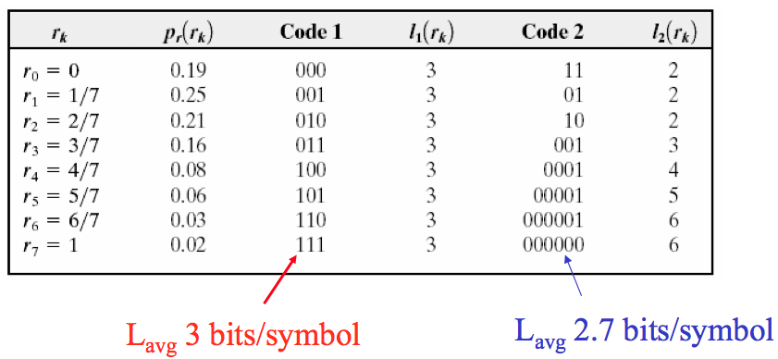
Coding Redundancy
Notes:
65

Slide 66
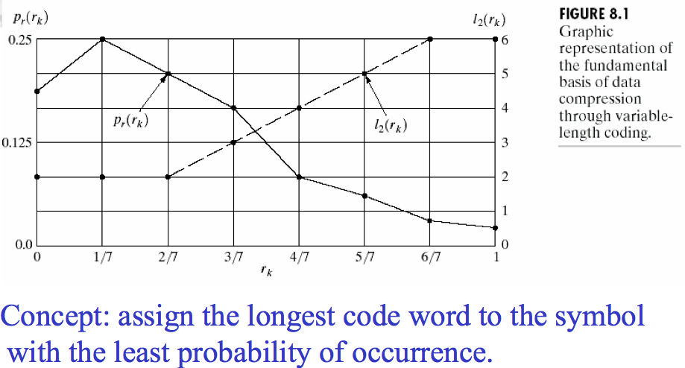
Coding Redundancy
Notes:
66

Slide 67
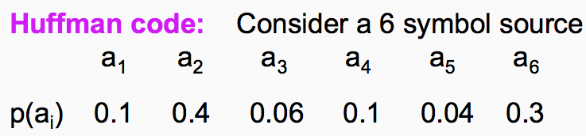
Huffman coding
Notes:
67

Slide 68
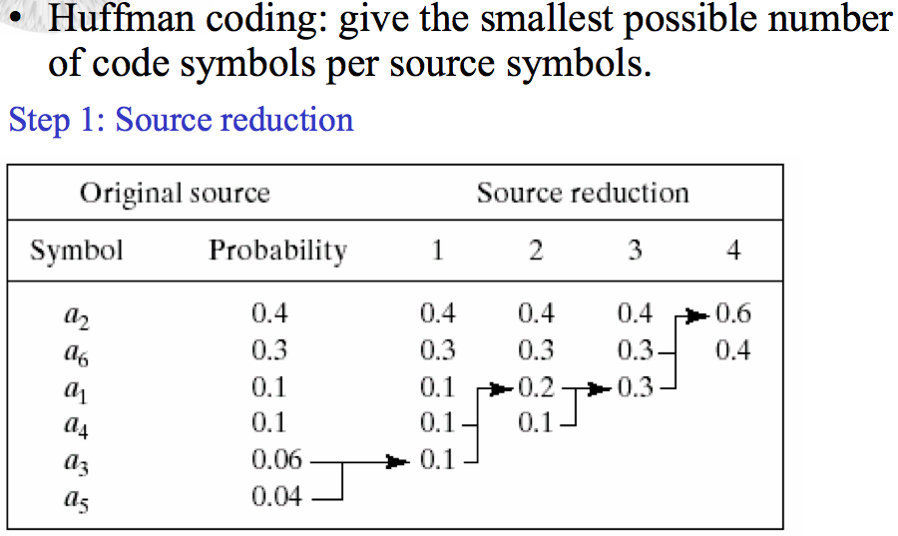
Huffman coding
Notes:
68

Slide 69
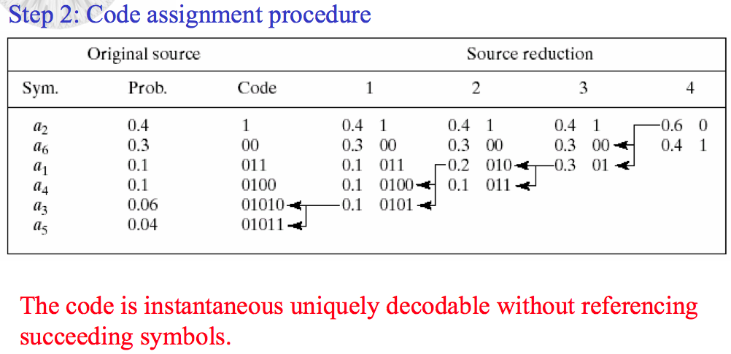
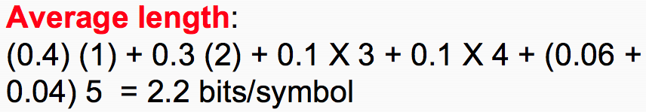
Huffman coding
Notes:
69

Slide 70
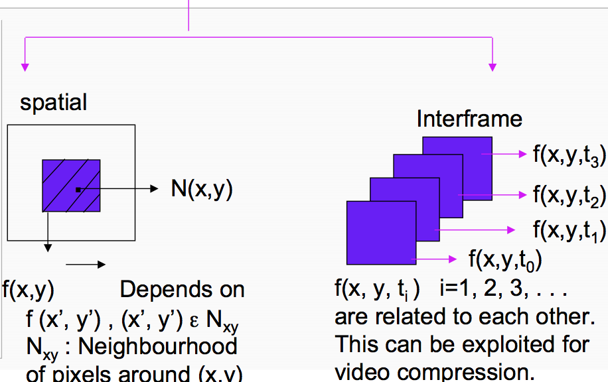
Interpixel / Interframe Redundancy
Notes:
70

Slide 71
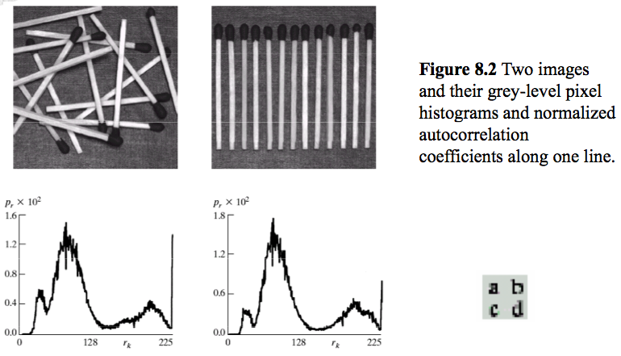
Interpixel / Interframe Redundancy
Notes:
71

Slide 72
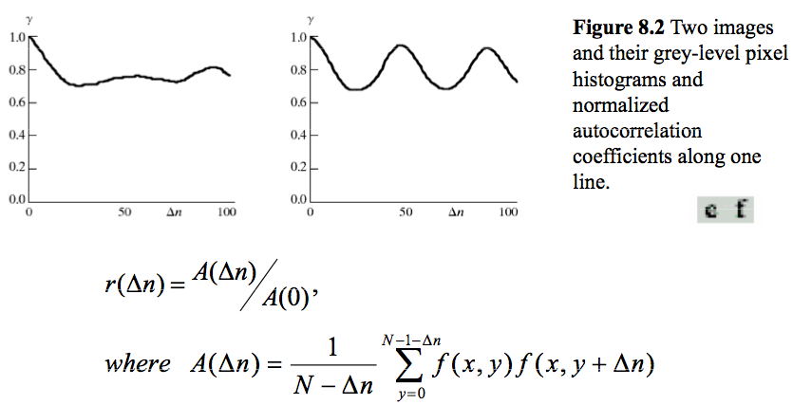
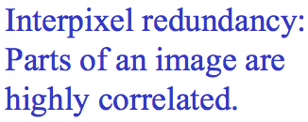
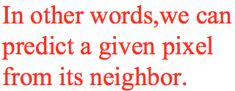
Interpixel / Interframe Redundancy
Notes:
72

Slide 73
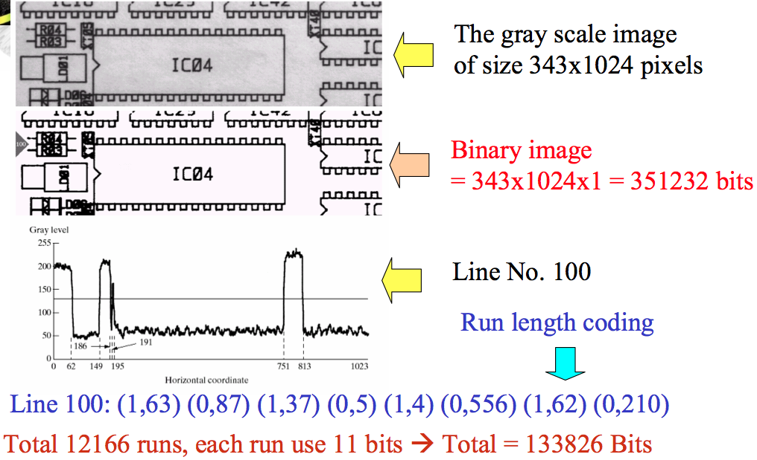
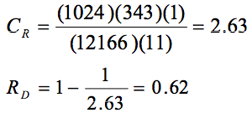
Run Length Coding
Notes:
73

Slide 74
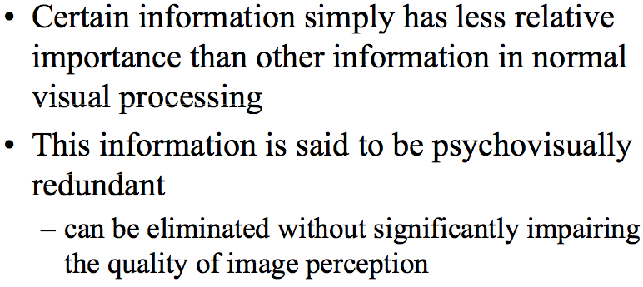
Psychovisual Redundancy
Notes:
74

Slide 75
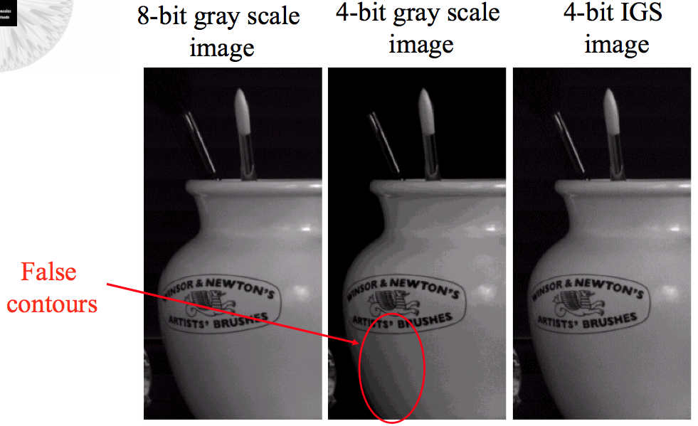
Psychovisual Redundancy
Notes:
75

Slide 76
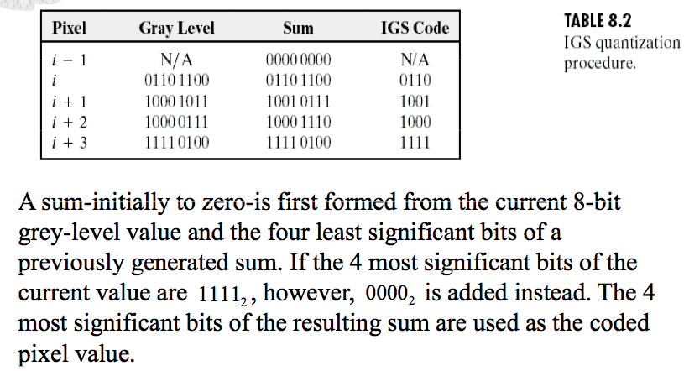
Psychovisual Redundancy
Notes:
76

Slide 77
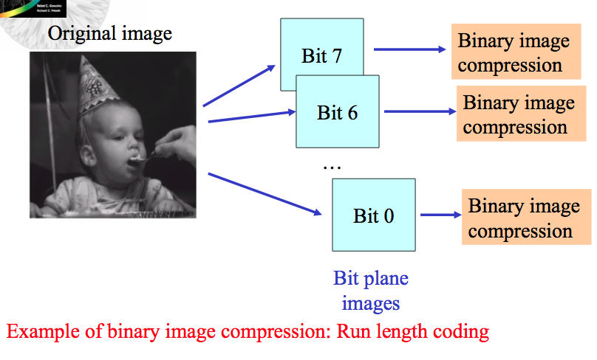
Bit Plane Coding
Notes:
77

Slide 78
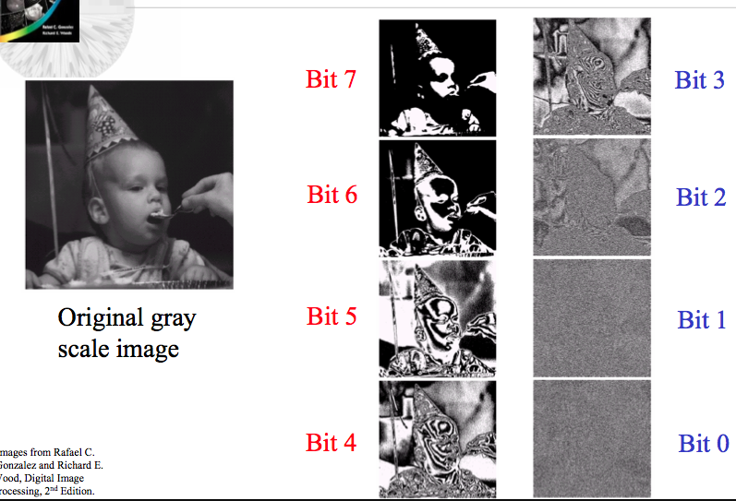
Bit Plane Coding
Notes:
78

Slide 79
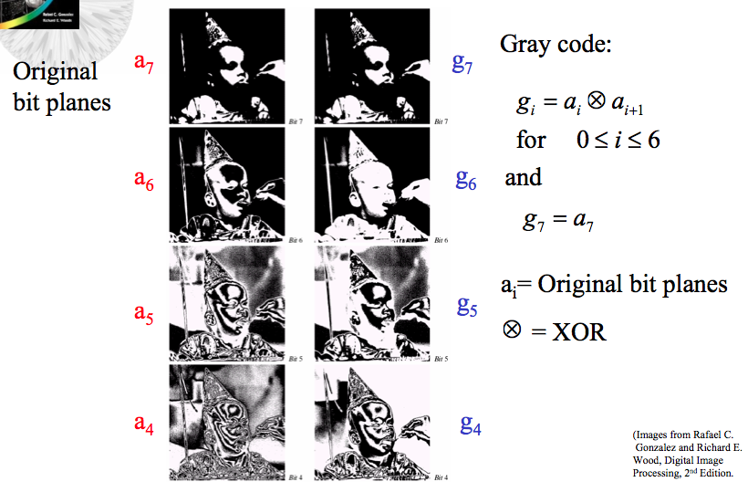
Gray Coded Bit Planes
Notes:
79

Slide 80
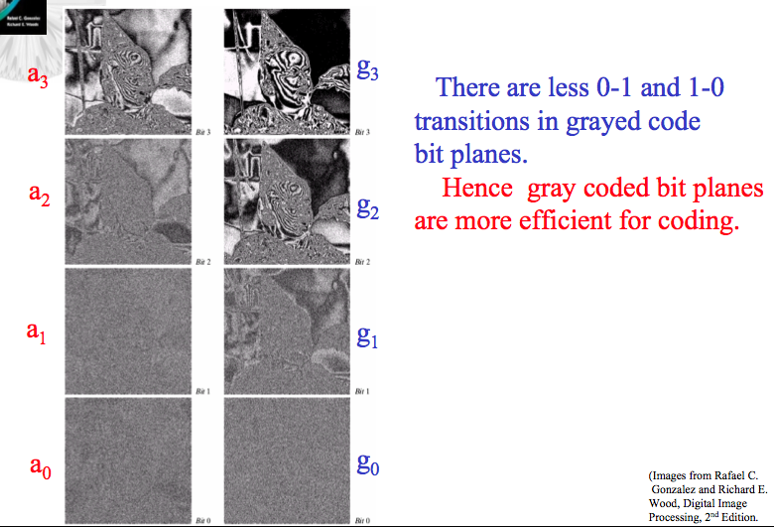
Gray Coded Bit Planes
Notes:
80

Slide 81
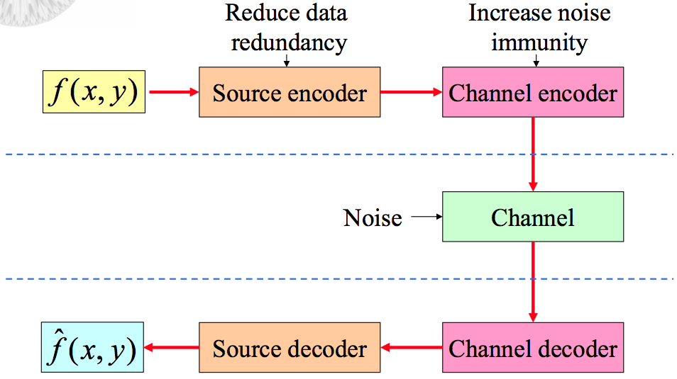
Image Compression Models
Notes:
81

Slide 82
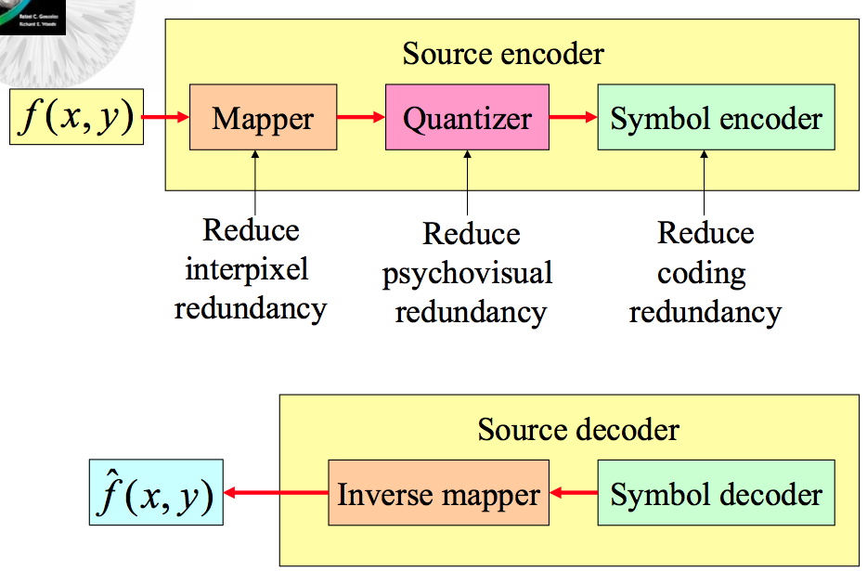
Source Encoder and Decoder Models
Notes:
82

Slide 83
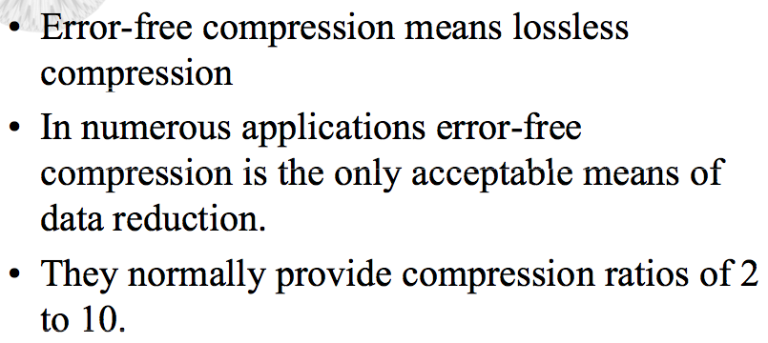
Error-Free Compression (Lossless)
Notes:
83

Slide 84
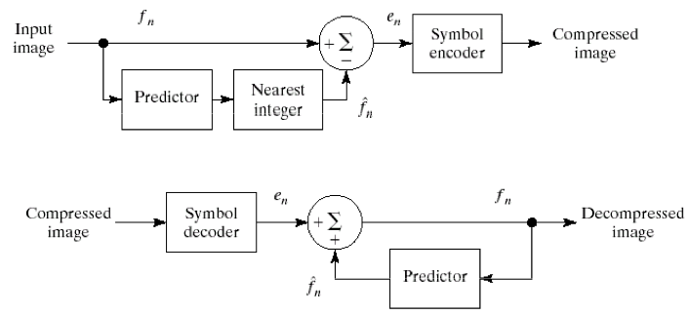
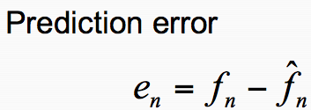
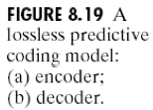
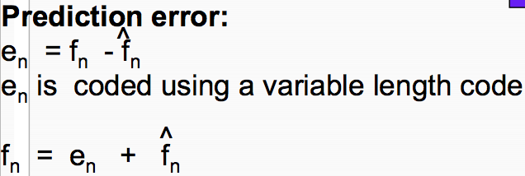
Lossless Predictive Coding Model
Notes:
84

Slide 85

Lossless Predictive Coding Model
Notes:
85

Slide 86

Lossy Compression
Notes:
86

Slide 87

Lossy Compression
Notes:
87

Slide 88

Lossy Compression
Notes:
88

Slide 89
Lossy Compression
0 | 0 | - | - | - | 0
1 | 1 | 0 | 1 | 2 | 2
2 | 2 | 1 | 1 | 2 | 4
3 | 3 | 2 | 1 | 2 | 6
4 | 4 | 3 | 1 | 2 | 8
5 | 5 | 4 | 1 | 2 | 10
6 | 6 | 5 | 1 | 2 | 12
Notes:
89

Slide 90

Lossy Compression
Notes:
90

Slide 91

Lossy Compression
Notes:
91

Slide 92

Lossy Compression
Notes:
92

Slide 93

Lossy Compression
Notes:
93

Slide 94
Lossy Compression
0 | 0 | - | - | - | 0
1 | 1 | 0 | 1 | 0 | 0
2 | 2 | 0 | 2 | 2 | 2
3 | 3 | 2 | 1 | 0 | 2
4 | 4 | 2 | 2 | 2 | 4
Notes:
94

Slide 95

Lossy Compression
Notes:
95

Slide 96

Lossless Vs. Lossy Coding
Notes:
96

Slide 97

Transform Coding
Notes:
97

Slide 98

Transform Coding
Notes:
98

Slide 99

Hadamard Transform
Notes:
99

Slide 100

Discrete Cosine Transform
Notes:
100

Slide 101

Transform Coding Example
Notes:
101

Slide 102


Transform Coding Example
Notes:
102

